Slide 1
Team 5
Project :- AI Chess Engine
Project Contributors
BIKASH PRADHAN 13030523022
DEBAGNIK DEY 13030523024
SANDIP SEN 13030523048
TIRTHES SAMANTA 13030523059

Slide 2



Project Purpose and Chess Engine Challenge
Chess serves as a classic benchmark for artificial intelligence, requiring a perfect blend of rigid rule enforcement and heuristic-based decision making. This project aims to build a functional chess engine in Python that handles the complexities of the game while providing a competitive AI opponent.
The Problem Statement
1. State Management
2. Rule Complexity
3. Search Space
Accurately tracking 32 pieces across 64 squares through thousands of possible permutations.
Implementing non-linear rules such as castling, en passant, and pawn promotion.
Navigating the "combinatorial explosion" where the number of possible move sequences exceeds capacity.

Slide 3




System Architecture and Board Representation
The engine is built on a modular architecture that separates the game state from the decision-making logic.
Move Generator
AI (Minimax)
Data Structures
Board Representation
2D 8×8 list where each element stores a piece object or null.
GameState
(8x8 Array)
Piece Encoding
Strings (e.g., 'wP', 'bK') for rapid lookup and rendering.
Move Log
Python/Pygame UI
Stack-based history that enables undo functionality for AI search.
Rule Validator

Slide 4


Legal Move Generation and Piece Validation
Piece | Movement Logic | Special Constraints
Pawns | Forward 1 (or 2 on start), Diagonal capture | En Passant, Promotion
Knights | Fixed "L" shapes (2x1) | Can jump over other pieces
Sliding | Ray-casting (Rook, Bishop, Queen) | Blocked by friendly/enemy pieces
King | 1 square in any direction | Castling (requires safety check)
Validation Pipeline
01
02
03
Pseudo-Legal Generation
Safety Check
Final Filter
Calculate all squares a piece can physically reach.
Temporarily apply the move and check if the King is under attack.
If the move results in a self-check, it is discarded from the legal move list.

Slide 5
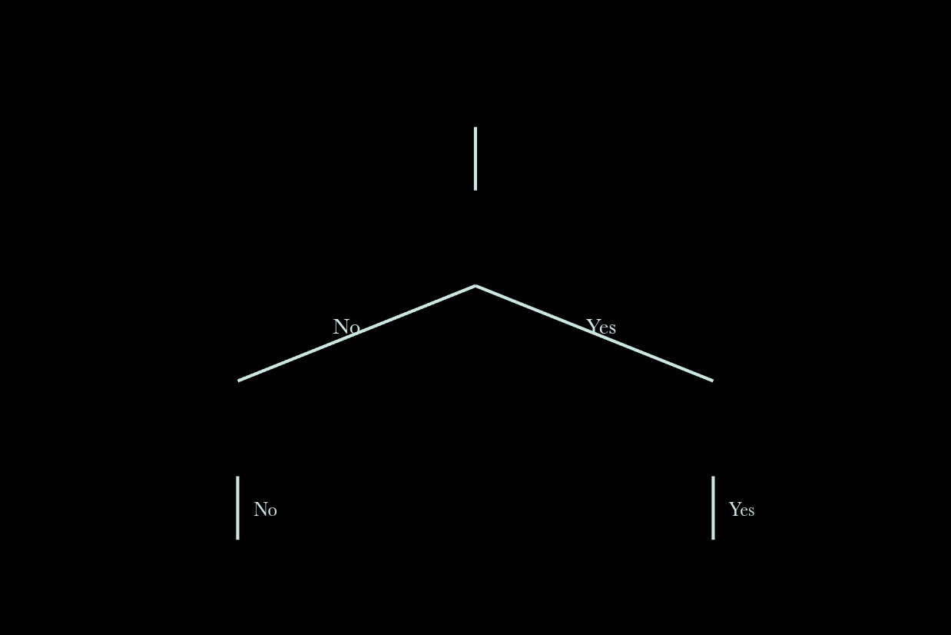
Check, Checkmate, and Stalemate Logic
TERMINAL STATE DECISION TREE
End-Game Detection Flow
Are there legal moves?
Check: Occurs when the King's current square is among the opponent's valid capture targets.
Continue Game
Is King in Check?
Checkmate: Triggered when the King is in check and the "Legal Move List" is empty.
Stalemate
Checkmate
Stalemate: Triggered when the King is not in check, but the player has no legal moves.

Slide 6


AI Opponent with Minimax Search
The Evaluation Function
Search Strategy
1
Minimax
MATERIAL WEIGHT
POSITIONAL SCORING
Recursive algorithm maximizing AI score while assuming human minimizes it.
Pawn (1) Knight/Bishop (3) Rook (5), Queen (9)
Heatmaps rewarding center control and key attacks.
2
Depth Limit
Set to 2–4 plies (half-moves) for responsive gameplay in Python.
3
Recursive Branching
Each node in the tree represents a potential board state.
"The AI simulates future turns to find the move that minimizes the maximum possible loss."

Slide 7



Timer, Workflow, Results, and Future Scope
Project Execution
Results and Conclusion
10-Minute Timer: Dual-clock system with countdown threads. Workflow: Agile development (UI → Move Logic → AI Optimization).
The project successfully produced a playable chess engine capable of defeating casual players. The modular design allows for easy debugging of specific piece rules without breaking the AI logic.
Future Scope
Alpha-Beta Pruning
Opening Book
Transposition Tables
Optimize Minimax search by skipping redundant branches.
Database of standard starting moves to save computation.
Storing previously evaluated positions to avoid re-calculation.

